Slide 1


Two-Photon Spectroscopy of Trapped Atomic Hydrogen
Ronit Dutta
Final Year student of Integrated BS-MS in Physics
Indian Institute of Technology Kharagpur
Subject : LASER SPECTROSCOPY

Slide 2
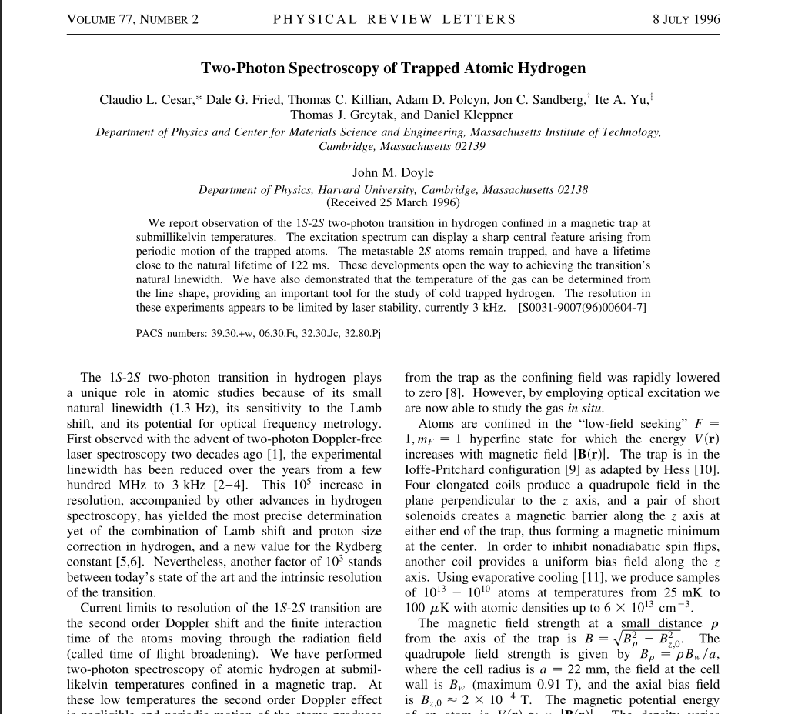


Portfolio Presentation | Ronit Dutta

Slide 3
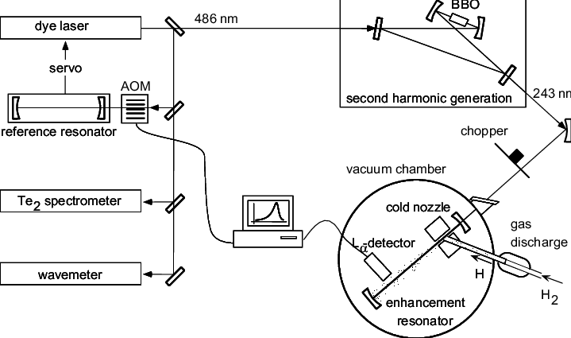
Objectives
Observe 1S–2S two-photon transition in magnetically trapped hydrogen at sub millikelvin temperature.
Achieve high spectral resolution by reducing Doppler and Time-Of-Flight (Transit-Time) broadening.
Analyze natural line shape under ultracold, confined conditions.
Measure metastable 2S state lifetime in the trap.
Enable BEC studies and optical frequency standard development.
1s-2s two-photon spectroscopy setup of atomic Hydrogen at submillikelvin temperature confined in a magnetic trap
Portfolio Presentation | Ronit Dutta

Slide 4
Significance of Precision Spectroscopy
Ultra-narrow natural linewidth: The 1s-2s transition of the hydrogen atom is 1.3 Hz enabling tests of quantum electrodynamics (QED), proton size, and an ultra-accurate estimation of the Rydberg constant.
Doppler-free nature: This is achieved via counter-propagating photons in a standing wave, which effectively cancels first-order Doppler shifts.
Sensitivity to fundamental constants: Shifts in the transition frequency reveal QED corrections (e.g., Lamb shift) and proton charge radius.
Portfolio Presentation | Ronit Dutta

Slide 5
Challenges in Achieving Natural Linewidth
Second-Order Doppler Broadening: High precision spectroscopy measurements, and light atoms second order doppler effect is significant. It scales with (v/c)²; significant at thermal velocities in non-cooled samples.
Time-of-Flight (TOF) Broadening (aka Transit-time broadening): Limited interaction time with the radiation field as atoms quickly traverse the laser beam. For plain cosine oscillator amplitude we get a simple sinc squared profile while for a gaussian beam one would get a gaussian linewidth.
Laser Instability: Reference cavity fluctuations and mechanical vibrations add linewidths ≥3 kHz
Portfolio Presentation | Ronit Dutta

Slide 6


1s-2s two-photon transition
Two-photon transitions require absorption of two photons with total angular momentum change . This however is not a part of Lyman series. For hydrogen’s 1S (n = 1) to 2S (n = 2) transition, the energy is given by :
Here R_H = Rydberg constant.
In Doppler-free spectroscopy, using counter-propagating laser beams to form a standing wave cancels the first-order Doppler shift:
Residual broadening arises from second-order Doppler effects and finite interaction time with the radiation field.
The transition rate is proportional to the intensity squared, enabling narrow resonances.
Portfolio Presentation | Ronit Dutta

Slide 7


Confinement in a Magnetic Trap
Atoms in the F = 1, hyperfine state experience a trapping potential given by
In thermal equilibrium, the density follows a Boltzmann distribution which is given by
This defines a thermal radius which is given by :
Portfolio Presentation | Ronit Dutta

Slide 8



Line Broadening Mechanisms
Coming back to the several broadening mechanisms we have :
Second-order Doppler shift :
Time-of-flight (TOF) broadening:
. This introduces a Lorentzian linewidth.
Trap-induced motional narrowing:
The reference paper notes that the trapped atoms, while oscillating, produce interference (motional narrowing) effects. These features have linewidths that are determined not by the typical transit-time but by the intrinsic properties of the trap and the periodic sampling of the excitation field. This results in a central feature that is significantly narrower than if TOF effects were dominant. Thus, coherent interactions over multiple oscillations reduce effective linewidth.
Portfolio Presentation | Ronit Dutta

Slide 9
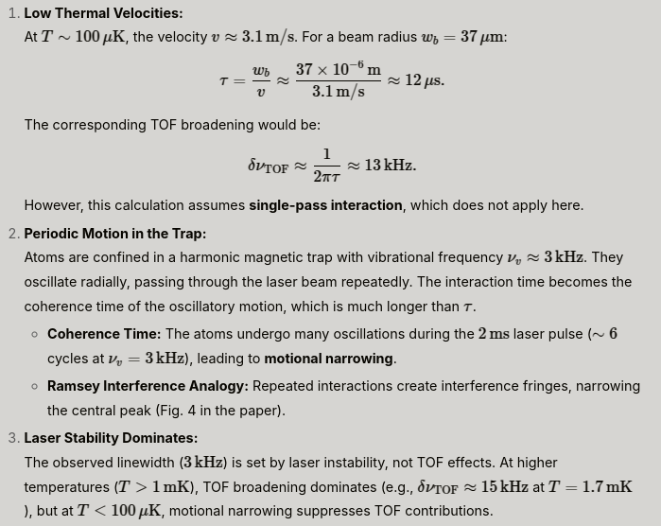
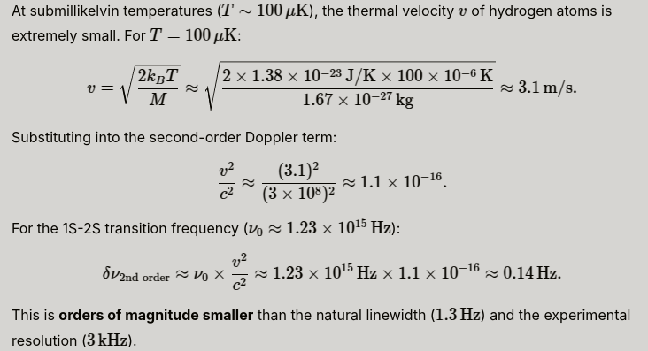
Line Broadening Mechanisms
Justification for Neglecting second order Doppler and TOF effect.
Portfolio Presentation | Ronit Dutta

Slide 10
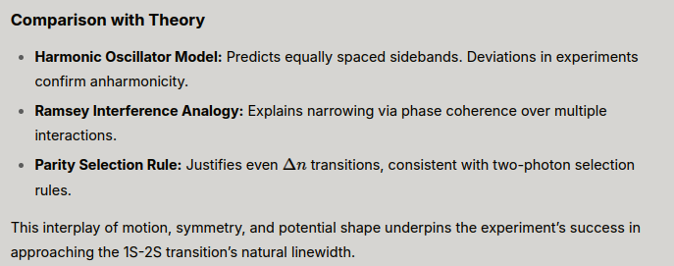
Spectral Features in the trap
Central narrowing: Cold atoms near the trap center experience harmonic motion, leading to interference fringes (Ramsey-like).
Sidebands: are produced due to vibrational energy. Spaced by due to quantized vibrational energy changes.
Anharmonicity effects: At larger radii, trap potential deviates from harmonic, broadening outer sidebands.
Portfolio Presentation | Ronit Dutta

Slide 11
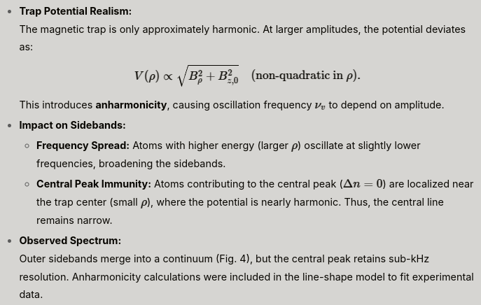
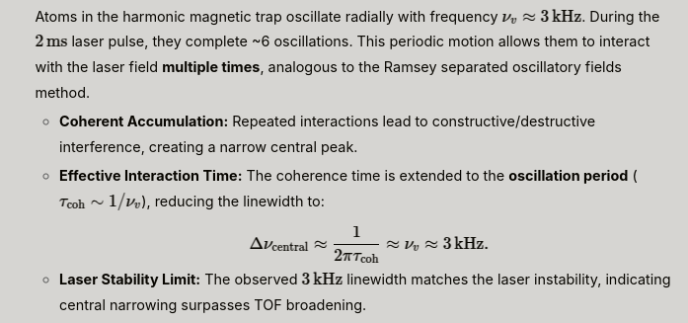
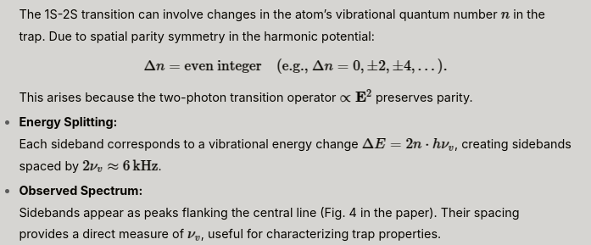
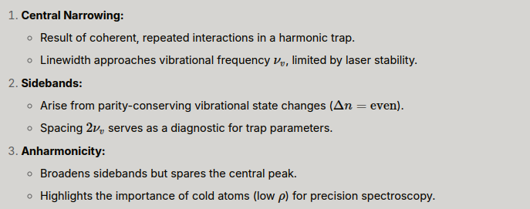
Spectral Features in the trap
Anharmonicity effects :
Central narrowing :
Sideband Formation :
Portfolio Presentation | Ronit Dutta

Slide 12
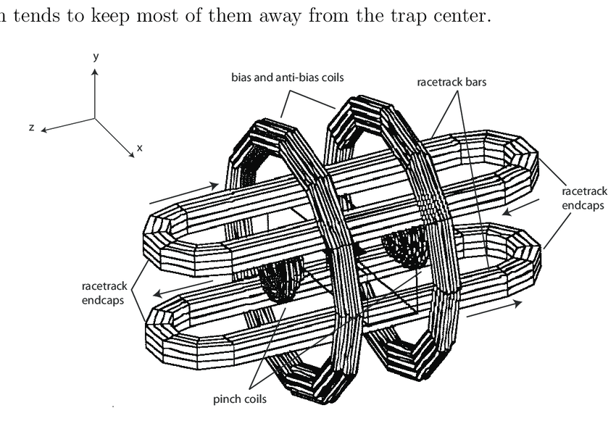


Confinement in a Magnetic Trap
The experiment utilizes an Ioffe-Pritchard trap configuration that combines a quadrupole field for radial confinement and axial solenoids to create a longitudinal barrier, forming a three-dimensional magnetic minimum. The quadrupole field is described by :
For small oscillations, the vibrational frequency is given by:
a = 22 mm, B_w <= 0.91 T.
At T = 100 microKelvin, thermal radius is approx 40 micrometer.
Portfolio Presentation | Ronit Dutta

Slide 13
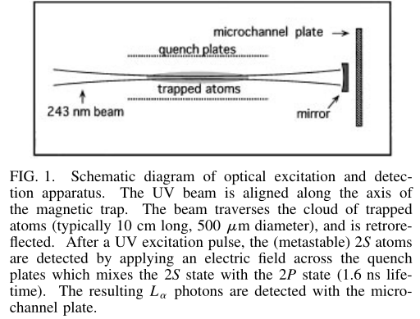
Confinement in a Magnetic Trap
Portfolio Presentation | Ronit Dutta

Slide 14
Confinement in a Magnetic Trap
Evaporative Cooling : Forced evaporation removes high-energy atoms, cooling the sample to approximately 100 µK by lowering the trap depth. The number of atoms varies from 10^13 to 10^10 and the density reaches up to 6 × 10^13 per cm which is adjustable via trap depth.
Laser System : The laser system starts with a 486 nm dye laser, which is locked to a reference cavity, and then frequency-doubled to 243 nm. The beam parameters include a waist radius of w0 = 37 µm stabilized to a reference cavity (3 kHz linewidth) with divergence length 18 mm. and Power = 4 mW, pulsed for 2 ms.
Detection scheme : The detection scheme starts with the 2 ms UV pulses which are used to drive the 1S-2S transition; then, an electric field (8 V/cm) Stark-mixes the 2S and 2P states, inducing Lyman-alpha (λ = 122 nm) decay; finally, microchannel plates collect the photons with an efficiency of 4 × 10−6 .
Portfolio Presentation | Ronit Dutta

Slide 15

Spectroscopy and Line Shape Analysis
Time-of-Flight Broadened Spectrum: At temperatures T > 1 mK, the observed line shape follows
For example, for T = 1.7 mK, δ0 = 11 kHz yields a full width at half maximum (FWHM) of approximately 14 kHz.
Motional Narrowing and sidebands: Due to the periodic radial motion of the atoms, they interact repeatedly with the laser in a manner akin to Ramsey interferometry. This periodic motion results in a sideband structure where energy changes of
produce sidebands spaced by 2𝛎 ≈ 6 kHz. The central peak is narrowed to a width limited by laser stability (approximately 3 kHz), which demonstrates the motional narrowing effect.
Portfolio Presentation | Ronit Dutta

Slide 16
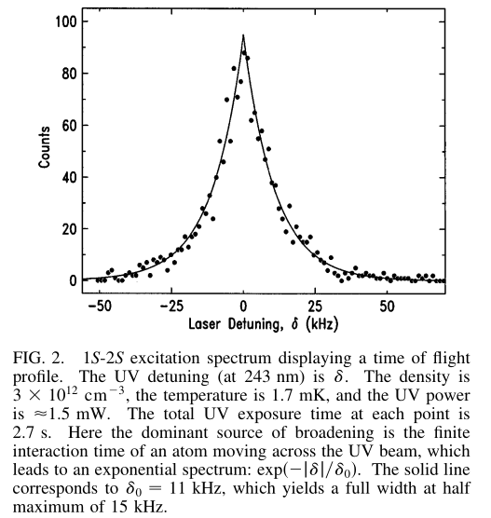
Spectroscopy and Line Shape Analysis
TOF broadening
Portfolio Presentation | Ronit Dutta

Slide 17
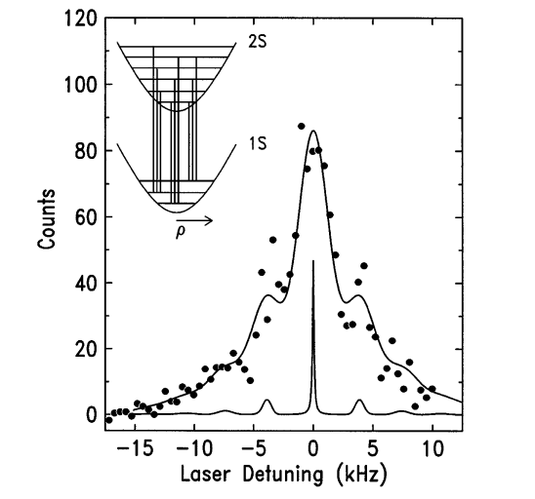
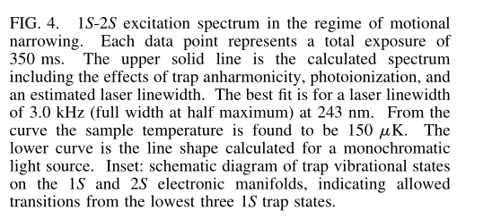
Spectroscopy and Line Shape Analysis
Motional Narrowing effect
Portfolio Presentation | Ronit Dutta

Slide 18

Spectroscopy and Line Shape Analysis
Temperature Determination:
Temperature was determined by three methods: (a) linewidth fitting using
(b) Trap dumping by measuring the energy distribution and velocity of escaping atoms, and (c) Evaporative cooling model that balances between heating and cooling rates.
All three methods agreed within experimental error, validating spectroscopy as a reliable tool for thermometry.
Portfolio Presentation | Ronit Dutta

Slide 19
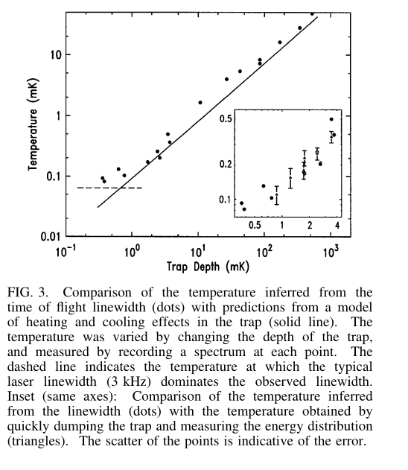
Spectroscopy and Line Shape Analysis
Temperature Determination
Portfolio Presentation | Ronit Dutta

Slide 20
Lifetime of the metastable 2S State
Delayed quenching measurements revealed 2S lifetimes in the range of 50 − 110 ms, which are close to the natural lifetime of 122 ms. Although stray electric fields and collisions may reduce the lifetime, no systematic damping was observed.
Quenching mechanisms: (a) Stray electric fields: Dominant loss at E > 1 V/cm.
Collisions: Negligible due to low density (n ∼ 10^13 cm^−3 ).
Portfolio Presentation | Ronit Dutta

Slide 21

Sources of Line Shifts and Broadening
Zeeman Shift : The Zeeman shift is calculated using the formula:
where α is the fine-structure constant.
Density-Dependent Shifts: Atom-atom interactions result in pressure shifts that alter the transition frequency.
Technical Limitations: The current spectral resolution is limited by the laser’s stability, which is about 3 kHz.
Portfolio Presentation | Ronit Dutta

Slide 22
Discussion & Implications for Future Research
Achievements and Limitations :
Resolution : Laser stability (3 kHz) now limits resolution, not TOF or Doppler effects.
Anharmonicity : Broadens sidebands but spares the central peak.
Lifetime : Confirms 2S metastability, enabling long interrogation times.
Implications for BEC and Optical Clocks Metrology :
At T ∼ 100 µK, hydrogen’s phase-space density is close to the condensation threshold. Spectroscopy can be used to detect BEC via phenomena such as the recoil shift (approximately 7 MHz shift for condensed atoms) and the observation of spatial localization through a density peak at the trap center.
Hydrogen spectroscopy offers advantages over ion clocks by providing higher signal rates (around ∼ 103 counts/s) while achieving comparable resolution, thus promising improved optical frequency standards.
Portfolio Presentation | Ronit Dutta

Slide 23
Conclusion
This work demonstrates two-photon spectroscopy of trapped hydrogen with a resolution of 3 kHz, limited solely by laser stability.
Key achievements include the observation of motional narrowing, which reveals a central peak that is 100 times narrower than those observed with previous methods; the validation of in situ thermometry against independent techniques; and lifetime measurements that confirm minimal environmental perturbations.
Future improvements in laser stability and further lowering of temperatures (T < 10 µK) could allow the intrinsic 1.3 Hz natural linewidth of the transition to be resolved, thereby enabling more rigorous tests of QED and the development of new optical frequency standards.
Portfolio Presentation | Ronit Dutta

